Slide 1
Session 7
Web API and Web Security
For Aptech Centre Use Only

Slide 2
Session Overview
Define Application Program Interface (API)
Describe how to create an ASP.NET Web API project
Describe ASP.NET HTTP client
Explain how to use Web API with ASP.NET Web forms
Define Web security
For Aptech Centre Use Only

Slide 3
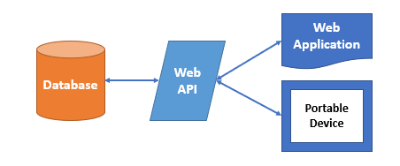
Overview of Web API
HTTP services can be built using the ASP.NET Web API framework.
Browsers, mobiles, tablets, and various other clients use these HTTP services.
For Aptech Centre Use Only
MVC
Web API
Standalone Web Service Applications
Web Applications
Web API Framework

Slide 4
Feature of Web API (1-2)
Supports convention based CRUD Actions
Includes accept header and HTTP status code to responses
Does formatting of responses into JSON, XML, or any format by MediaTypeFormatter Accepts and generates content, such as images and PDF files
Supports Open Data Protocol (OData) automatically Hosts within application or on IIS
Simple and robust using routing, controllers, action results, and filter
For Aptech Centre Use Only

Slide 5





Feature of Web API (2-2)
Database
Business Logic
Business Logic
For Aptech Centre Use Only
Business Logic
Database
API
Business Logic
Web Server with Business Logic
Business Logic
Architecture Without API
Architecture With API

Slide 6
Reasons For Choosing Web API
 | Used for building simple, non-SOAP-based HTTP services on existing WCF message
 | pipeline.
 | No need of tedious configuration, such as WCF REST service.
 | Used when requiring a simple service creation with Web API.
For Aptech Centre Use Only
 | Based only on HTTP and is simple to describe, show, and utilize in a RESTful manner.
 | Useful for devices that have limited bandwidth such as smartphones.
 | Based on a light weight architecture and is open source.

Slide 7
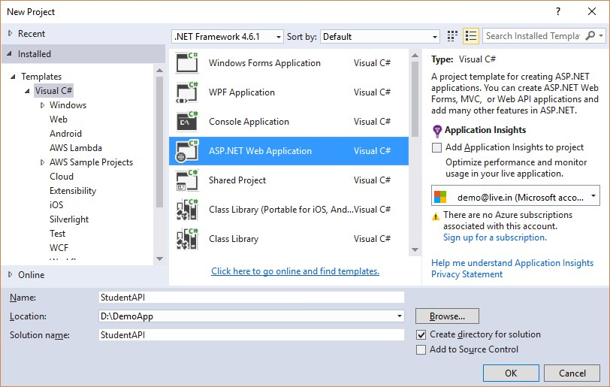
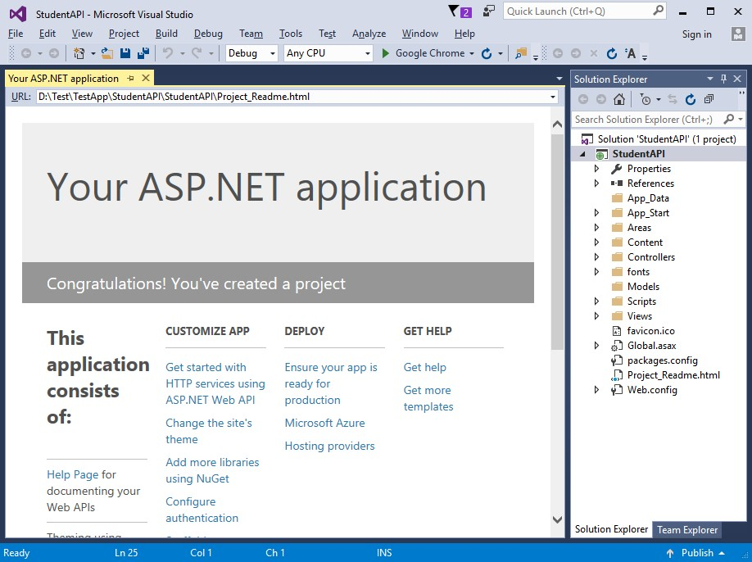
Creating a Web API Project
For Aptech Centre Use Only
New Project Window
New Project

Slide 8
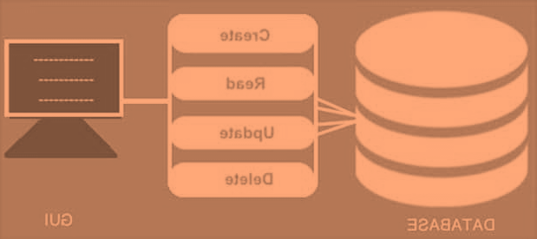
Creating a Web API that Supports CRUD Operations
One of the features of Web API is that it supports convention-based CRUD actions.
CREATE
For Aptech Centre Use Only
RETRIEVE
UPDATE
DELETE
Application
Database

Slide 9
Web API with Repository Pattern (1-3)
Repository pattern:
Isolates business objects from the data access layer and creates an abstract layer.
Reduces amount of code for automated unit testing and maximizes isolated data access from the data store.
Helps data access, code readability, and maintainability to be centralized and hence includes a flexible architecture.
For Aptech Centre Use Only

Slide 10
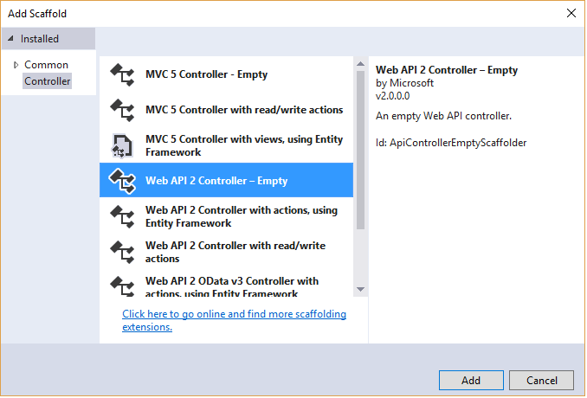
Web API with Repository Pattern (2-3)
For Aptech Centre Use Only
Web API 2 Controller - Empty

Slide 11
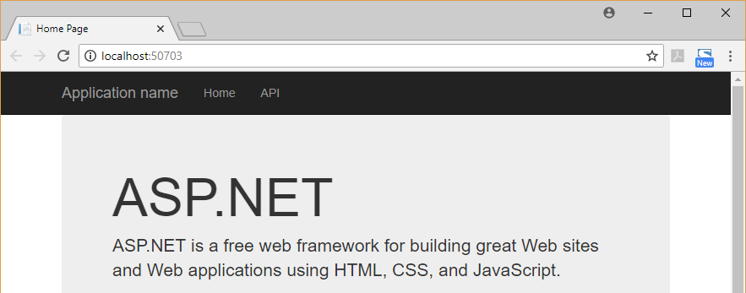
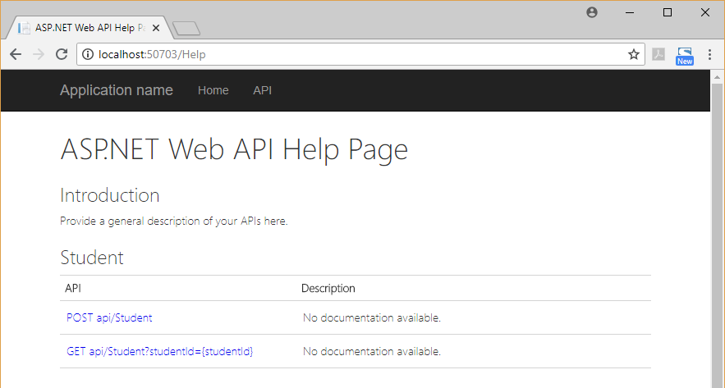
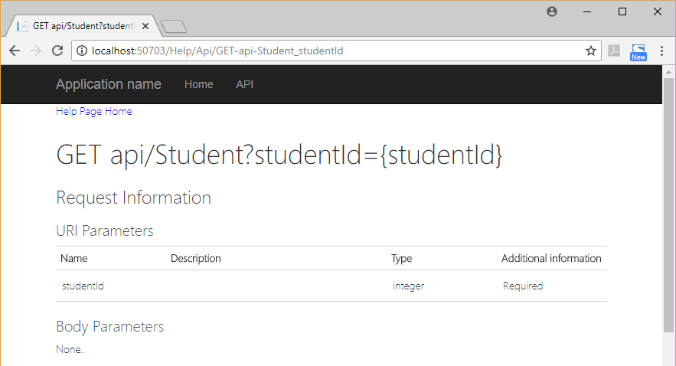
Web API with Repository Pattern (3-3)
For Aptech Centre Use Only
Web API Run Page
List of Web APIs
Web API Details

Slide 12
ASP.NET Web API and HTTP Client Samples
HttpClient performing an asynchronous call to the Web API
For Aptech Centre Use Only
Client Application
Web applications
Desktop applications
Mobile applications.
Web API Service
Database

Slide 13
Methods of the HttpClient Class
Method Description
GetAsync GET request is sent to a specified URI
PostAsync POST request is sent to a specified URI PutAsync PUT request is sent to a specified URI DeleteAsync DELETE request is sent to a specified URI
For Aptech Centre Use Only
Methods of the HttpClient Class
Following is the inheritance hierarchy: System.Object System.Net.Http.HttpMessageInvoker System.Net.Http.HttpClient Namespace: System.Net.Http
Assembly: System.Net.Http (in System.Net.Http.dll)

Slide 14
Methods of the Student ApiController
Method | HTTP Verb | Description
Get() | GET | All records are returned as IEnumerable
Get(int) | GET | A specific record object matching the specified parameter is returned
Post(Student) | POST | A new recorder is inserted into the database
Put(int, Student) | PUT | An existing record from the database based on a specific ID is updated
Delete(int) | DELETE | An existing record from the database based on a specific ID is deleted
Methods of the Student ApiController
For Aptech Centre Use Only

Slide 15
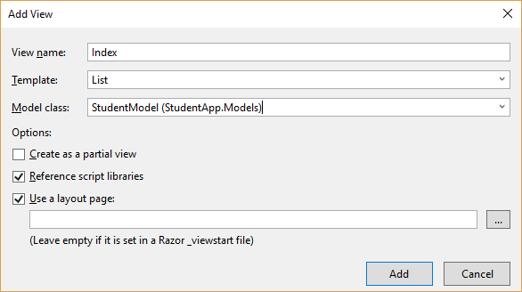
Using Web API with ASP.NET MVC Application
1. Create a new MVC Web application
2. Add model to the application
3. Add controller to the application
4. Add routing information to Global.asax
5. Make a client call
For Aptech Centre Use Only
MVC View Scaffolding

Slide 16
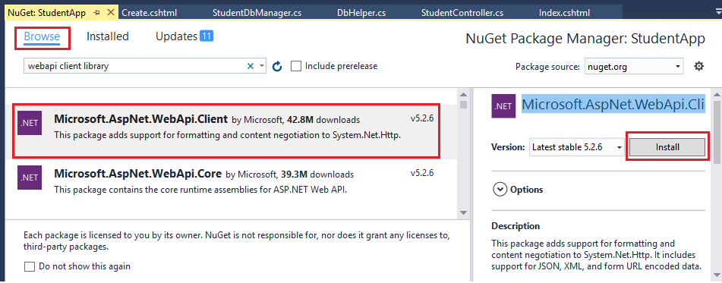
Calling Web API from the MVC Application (1-2)
For Aptech Centre Use Only

Slide 17
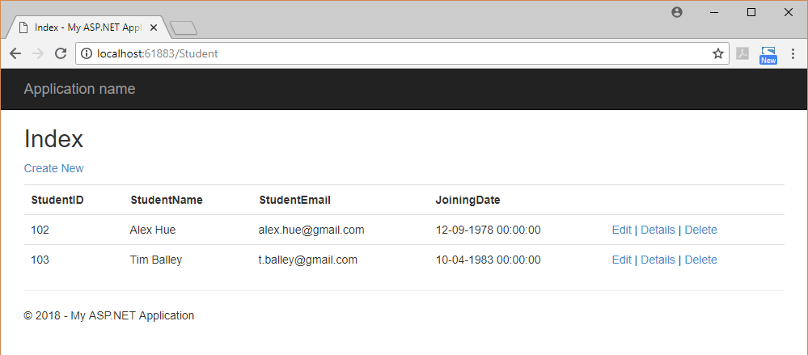
Calling Web API from the MVC Application (2-2)
For Aptech Centre Use Only
MVC Web Application Running with WebAPI

Slide 18
Introduction to Web Security, Authentication, and Authorization
Determining the identity of the user is called Authentication.
Deciding if the user can or cannot perform an action is called Authorization.
For Aptech Centre Use Only

Slide 19
Summary
MVC is a framework that helps developers to create Web applications in which sections of code are organized by the functions they perform.
Fundamental pattern component of an MVC application is the component called the view. It is accountable for rendering the user interface, irrespective of it being an HTML or a UI widget on a desktop application.
HTTP services are built using the ASP.NET Web API framework.
When the Web API framework receives an HTTP request, the action to be invoked is determined by the routing table.
HTTP requests/responses from a URL are sent/received using a base class that HttpClient provides.
.NET applications use the HttpClient component as an HTTP client.
ASP.NET Web API helps to program HTTP verbs, such as GET, POST, PUT, and DELETE.
It is possible to implement Web API with Web forms.
Determining the identity of a user is called authentication. Deciding whether a user is allowed to perform an action is called authorization.
For Aptech Centre Use Only

